Slide 1
TechDay#6 – Docker & Spring Boot
Abril 2017
Madrid – Barcelona - Jerez
Notes:
Portada Sedes

Slide 2



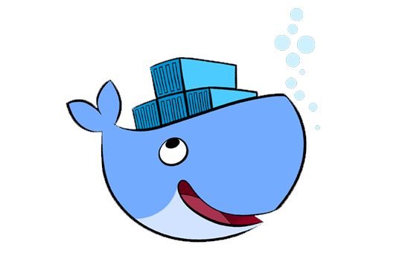

Contenido de la Sesión
Introducción a Spring Boot (30 min.)
Introducción a Docker (30 min.)
Desarrollo de un servicio con Spring Boot.
Encapsulación y ejecución del servicio desarrollado en un contenedor Docker.

Slide 3
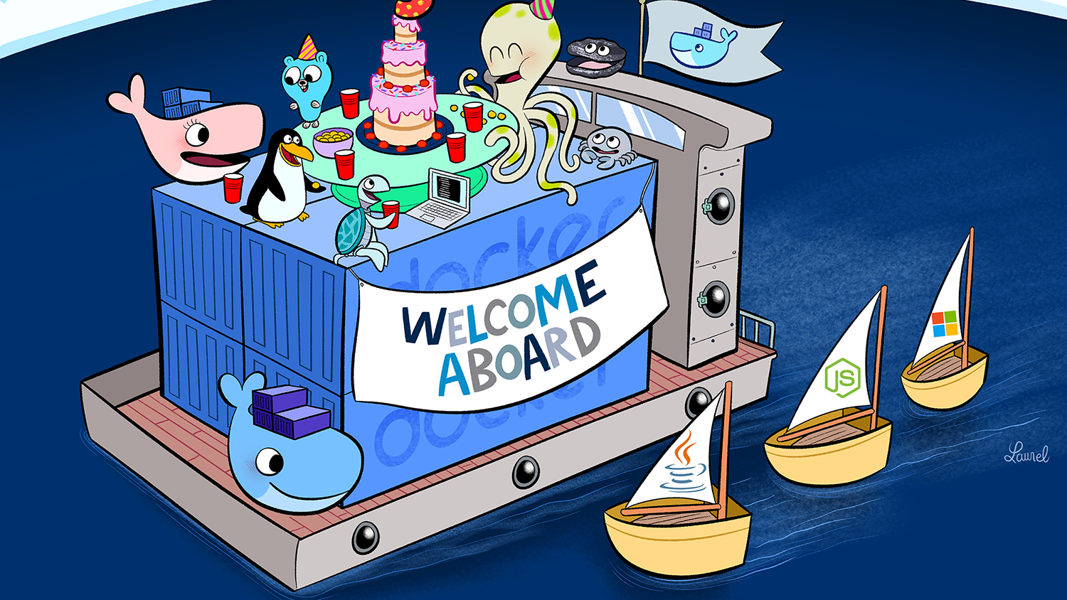

Slide 4
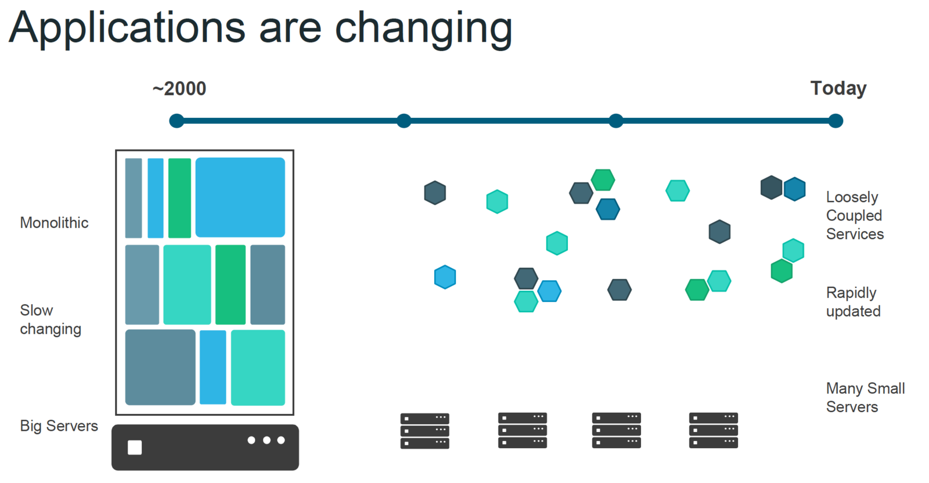

Slide 5
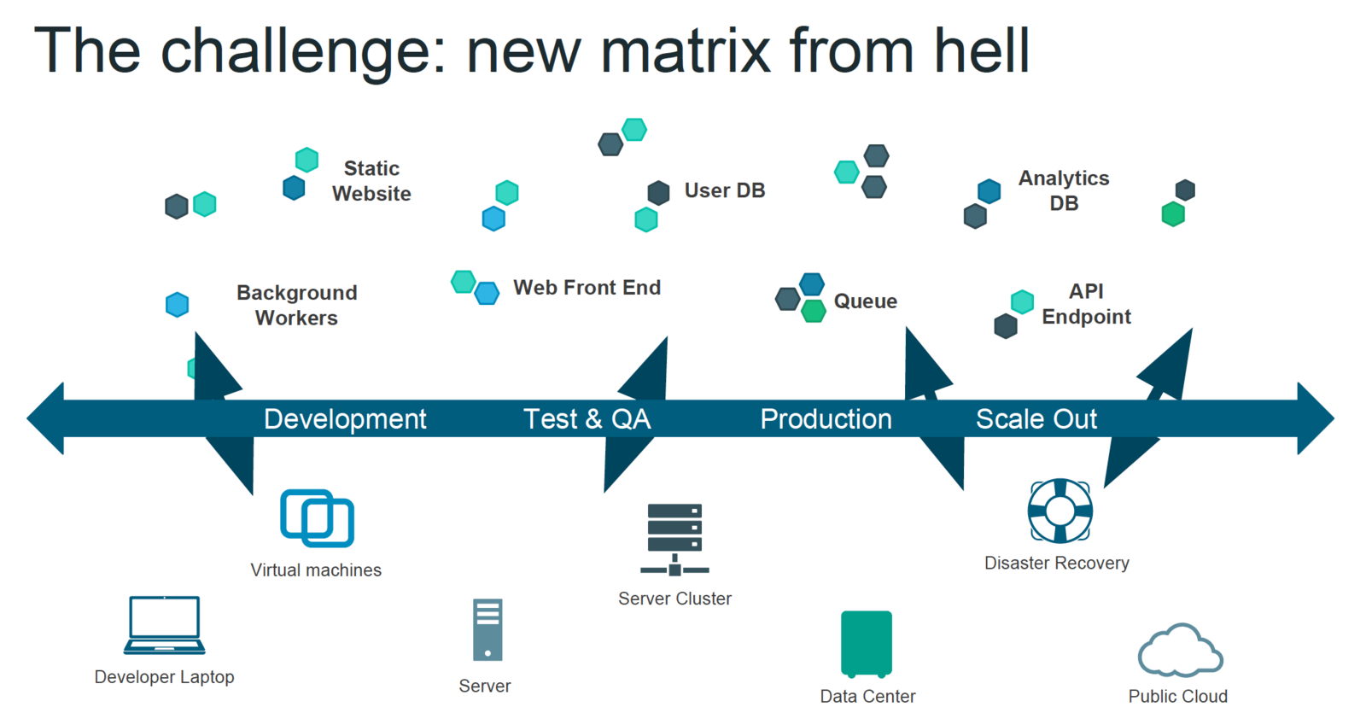

Slide 6
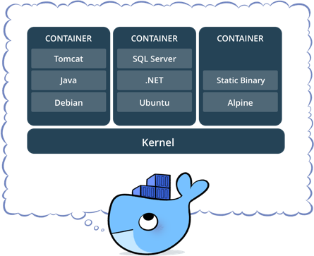
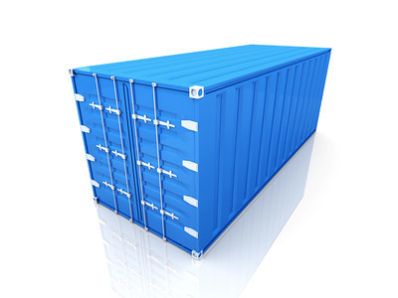
Linux Containers
Docker is based on LXC (Linux Containers) which allows
it to isolate containers from each other.
LXC use mainly two Linux Kernel features to achieve it :
Namespaces (Isolation of resources)
Cgroups (Isolation of resource usage, as CPU/RAM)

Slide 7
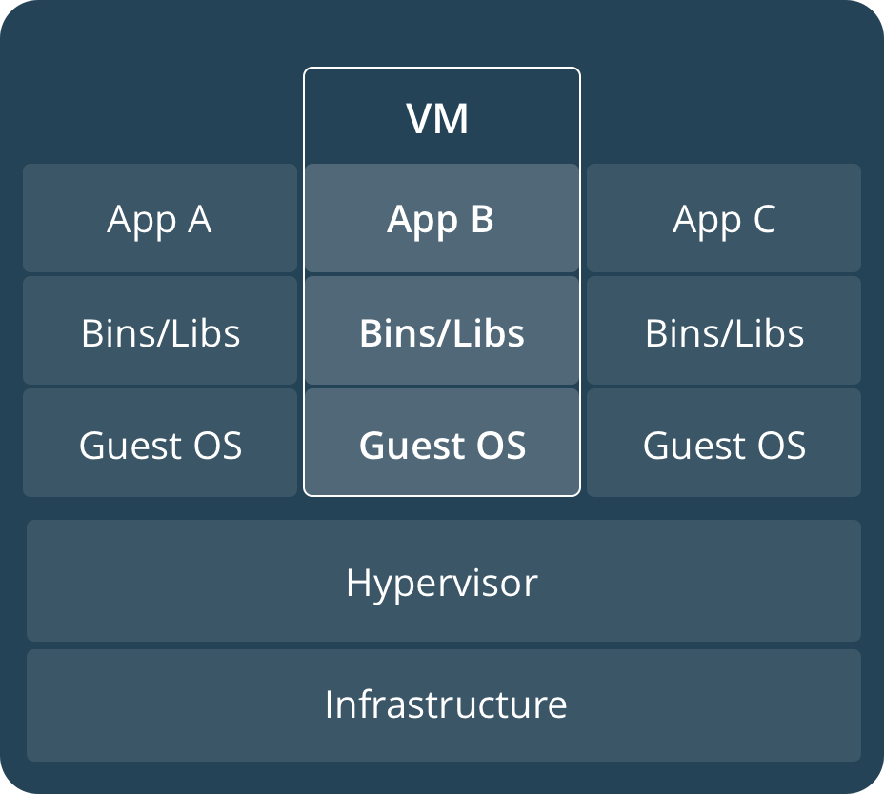
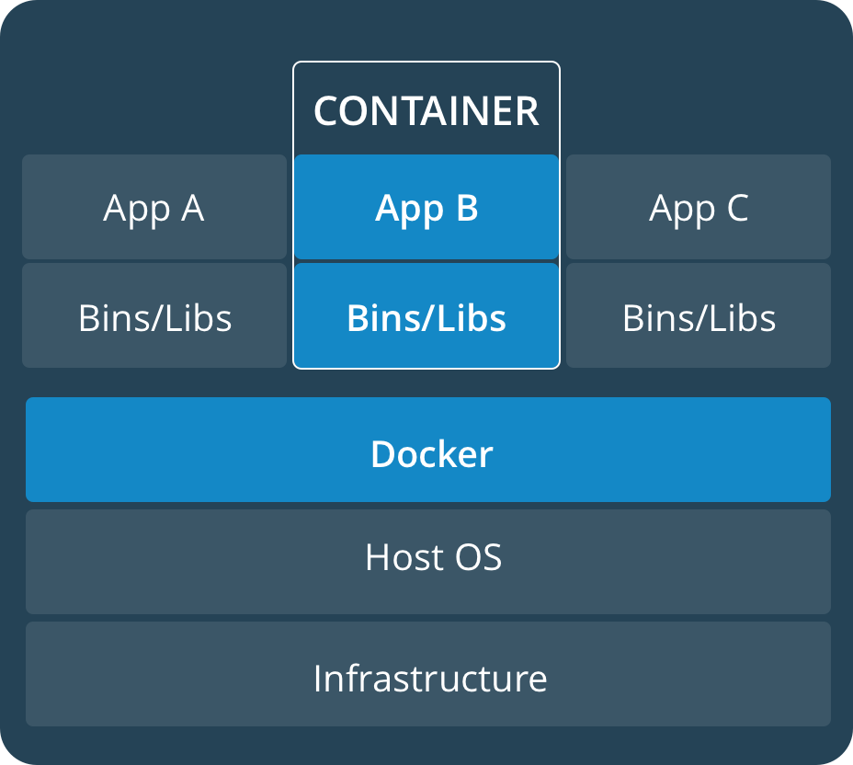
Virtual Machines vs Containers

Slide 8
Virtual Machines vs Containers (II)
Containers share resources with the host OS, which makes them an order of magnitude more efficient.
Containers can be started and stopped in a fraction of a second.
Applications running in containers incur little to no overhead to applications running natively on the host OS.
The portability of containers has the potential to eliminate a whole class of bugs caused by subtle changes in the running environment and missing libraries
—it could even put an end to the age-old developer refrain of
“but it works on my local machine!”

Slide 9
WHY DO DEVELOPERS CARE?
Build once…(finally) run anywhere
A clean, safe and portable runtime environment for your app.
No worries about missing dependencies, packages and other pain points during subsequent deployments.
Automate testing, integration, packaging…anything you can script.
Cheap, zero-penalty containers to deploy services.
Instant replay and reset of image snapshots.

Slide 10
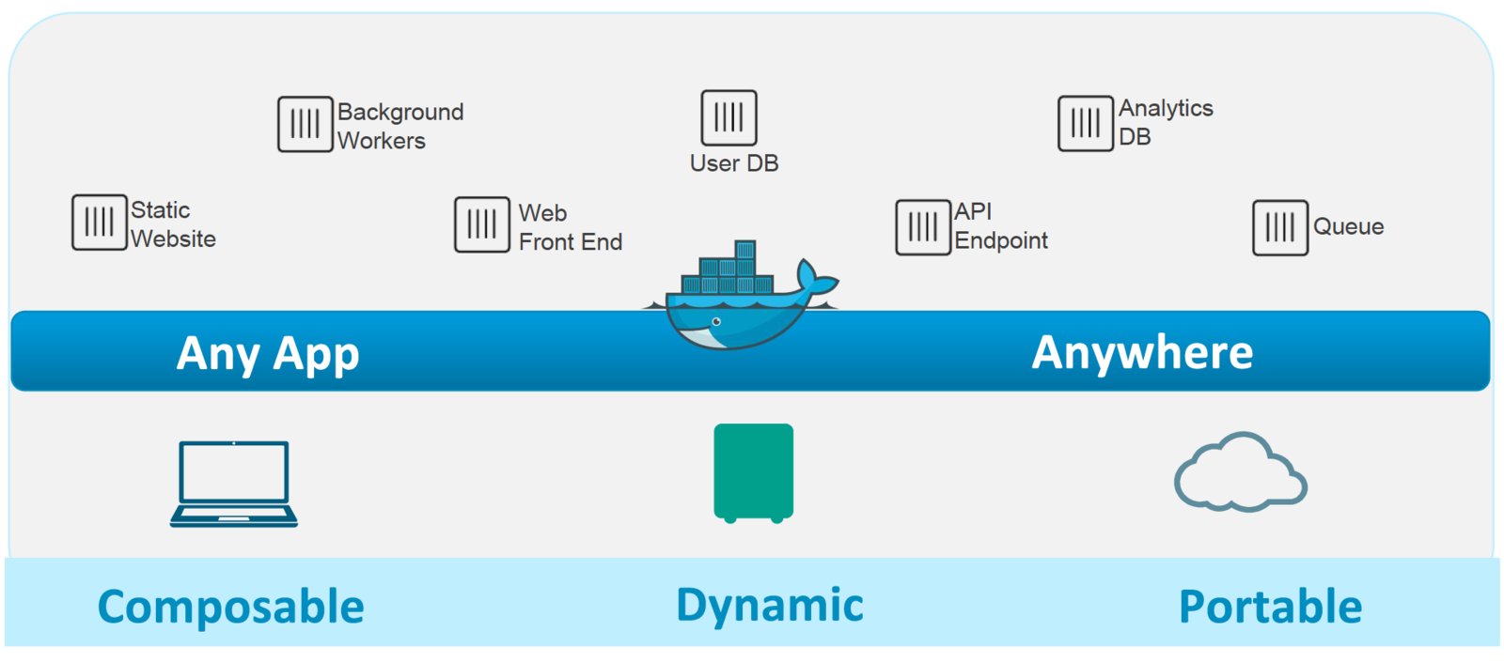
Dockerized ecosystem

Slide 11
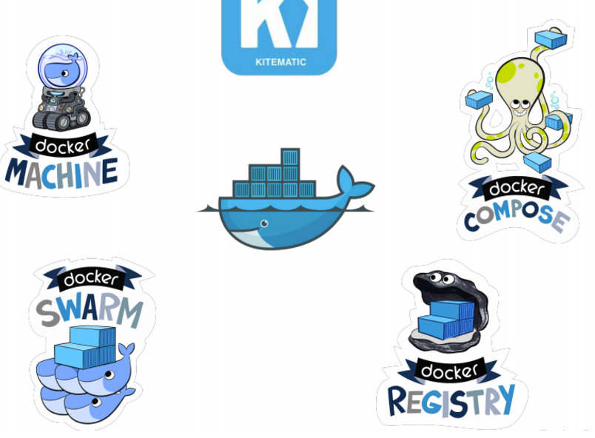
Docker Ecosystem

Slide 12
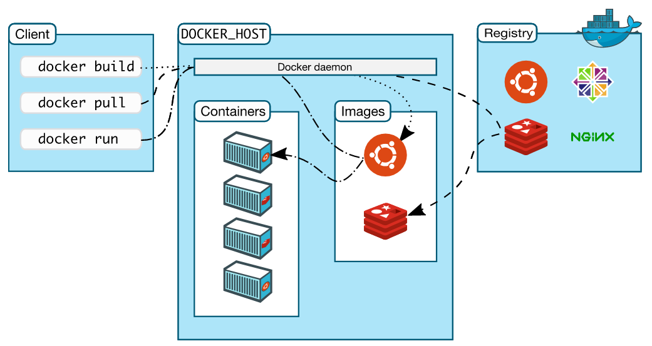
The Docker Architecture

Slide 13
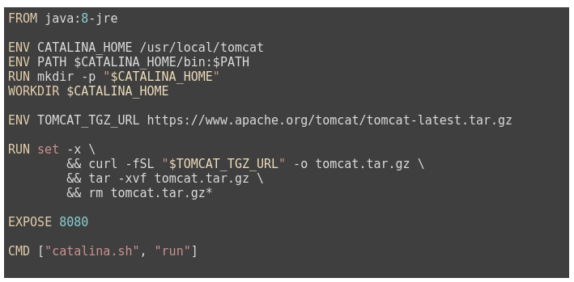
Anatomy of a Dockerfile
An image is built from a Dockerfile. A file describing how the image is supposed to behave, what it extends from, ...

Slide 14
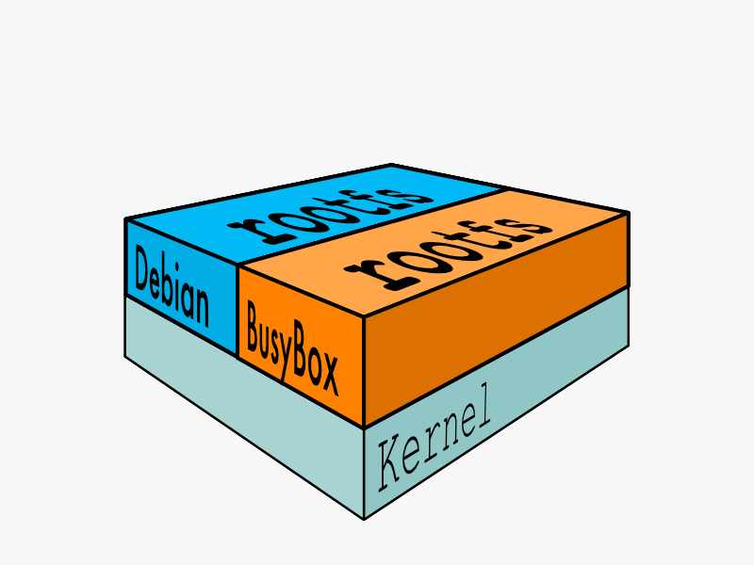
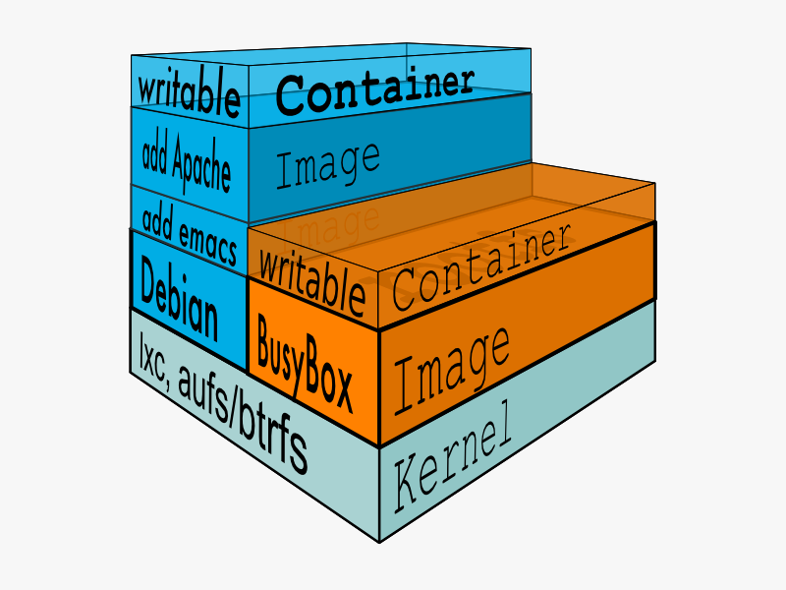
How images get built

Slide 15
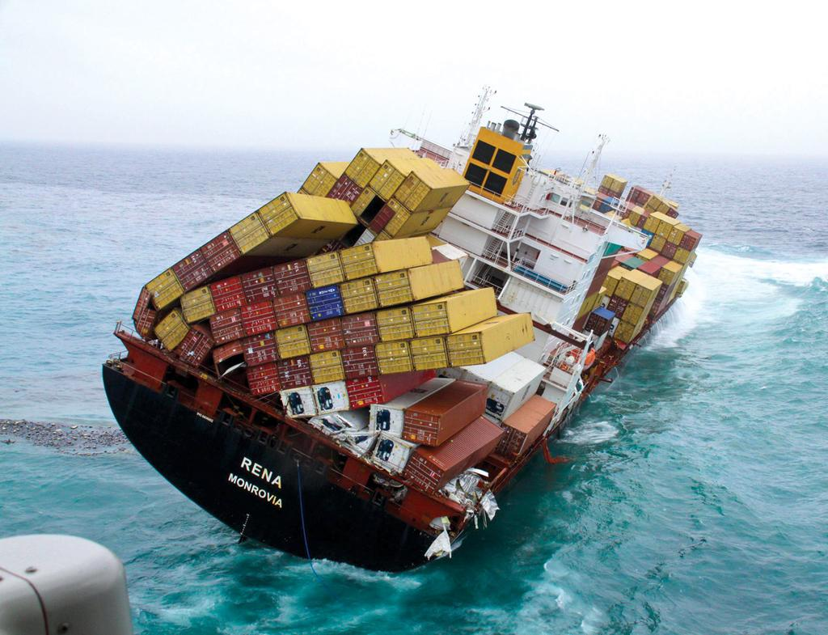
Workshop time!!

Slide 16
GRACIAS

